Slide 1
‘Futures? Dementia and Human (Re)generation in Contemporary Culture’
Dr Lucy Burke, Manchester Metropolitan University

Slide 2
Crisis capitalism
“Regenerative medicine is rooted in the modern bio- medical deconstruction of death, which underlies the contemporary technoscientific fantasy of indefinitely extending longevity."
Ageing has become a ‘crisis’ that “cannot be separated from the emergence of a bioeconomy based on the pharmaceutical industry, genetic engineering and the development of biomedical research as a whole”
(Céline Lafontaine, ‘Regenerative Medicine’s Immortal Body: From the Fight against Ageing to the Extension of Longevity’ in Body & Society Vol. 15 No. 4, 2009)

Slide 3
Aims
To explore the ways in which dementia has emerged as an over-determined point of tangency upon which particular ideas about ageing, mortality and immortality, human value, sustainability and futurity are played out.

Slide 4
Thinking about dementia
Biomedical paradigm predominates
Dementia separated from ‘ageing’
Difficulty of identifying and differentiating distinct pathologies
Recent shift towards understanding the multifactoral nature of the condition

Slide 5
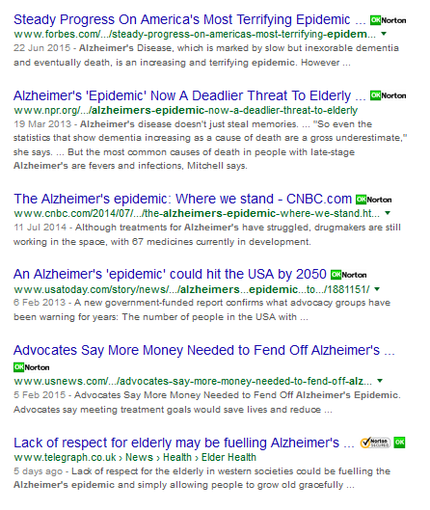
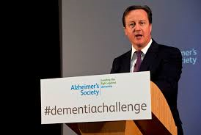
Wildfire and Tsunamis …
“Dementia is the greatest threat to humanity” (David Cameron’s #dementiachallenge)
Disaster capitalism complex

Slide 6
Renny Harlin, Deep Blue Sea, 1999

Slide 7
“What you are looking for here is lightening in a bottle. Neurons are becoming hyper osmotic. They are firing”.

Slide 8
End-times
The film allegorises the eradication of the forces of capitalist speculation (in the form of Russell Franklin, millionaire CEO and cannibal), of scientific research (destroyed by the elemental forces of fire and water), and of the scientists themselves.
Blue collar conservatism
Concludes with the deserted time of unemployment and historical paralysis.

Slide 9
Vernor Vinge’s Rainbows End (2006)
Speculative fiction
Set in San Diego 2025
World in which digital technologies permeate every space and expression of human sociality
Key protagonist: Robert Gu (cured of late stage AD)
“Today we did your eyes. In a week or so we’ll start reinforcing your peripheral nervous system.” Reed laughed. “You know you’ve even got the skin and fat biochemistry that responds to Venn-Kurasawa treatments.” (p.27)

Slide 10
The world of the novel
Makes no reference to work or production/reproduction
Predicated on the abstraction of technology from its mediation via the market/capitalism
Encapsulates the problem of imagining the future as anything but ”a monotonous repetition of what is already here”
See Fredric Jameson, ‘Future City, NLR (May/June 2003, p.76)
Life in the chronic mode:
Eric Cazdyn: “a mode of time that cares little for terminality or acuteness but more for an undying present …” and in which “the maintenance of the status quo becomes, if not quite our ultimate goal, what we will settle for”
See Eric Cazdyn, The Already Dead: The New Time of Politics, Culture and Illness (Durham: Duke, 2012, p.5).

Slide 11
Conclusion: regeneration, futurity and persistence
This paper has explored
the extent to which the contemporary meanings of dementia are tied to the logic of neoliberal marketisation
notion that investment in biotechnology will provide solution to resource crisis
Analysis of the film and novel enables us to acknowledge the the ideological limits of this discourse – via the identification of what remains unsaid and unacknowledged
Questions that persist require radical re-thinking of the ways we live and work, attitudes towards ways of dying and what it means to live well with a chronic or terminal condition.

