Slide 1
Pasts, Presents and Futures of Medical Regeneration

Slide 2
Background
Rejuvenation
To make young or fresh again; to restore to youth or to the appearance of youth; … to give new life to; to refresh, reinvigorate.
Regeneration
The action of coming or bringing into renewed existence; recreation; rebirth; restoration.
The formation of new tissue or cells; the natural replacement or repair of a lost or damaged part, organ, etc.; the formation of a new individual from part of an organism, often as a form of asexual reproduction.

Slide 3
Background
Rejuvenation
To make young or fresh again; to restore to youth or to the appearance of youth; … to give new life to; to refresh, reinvigorate.
Regeneration
The action of coming or bringing into renewed existence; recreation; rebirth; restoration.
The formation of new tissue or cells; the natural replacement or repair of a lost or damaged part, organ, etc.; the formation of a new individual from part of an organism, often as a form of asexual reproduction.

Slide 4
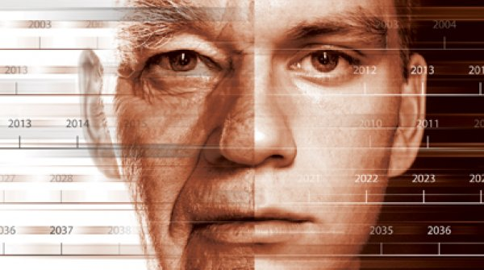
Regeneration
‘It is important to emphasise the limitations of ageing research. Promises of substantial increases in lifespan, reversing ageing or even immortality are unlikely to be fulfilled in the foreseeable future, if at all.’
Academy of Medical Sciences, 2009

Slide 5
Pasts | Presents | Futures
What are the similarities/differences between contemporary regenerative medicine and historical attempts to regenerate?
How and why have public perceptions about the experience/desirability of ageing changed?
What are the precursors to regenerative medicine and how/why did the field crystalise?
How is the emergence of regenerative medicine changing our relationship with our bodies?
How do features of medical regeneration manifest in popular culture? What is their significance?
How are commercial aspects of regenerative treatments likely to develop in the future?

Slide 6
Outcomes
Today
Curiosity
Exchange
Discussion
Eventually
Projects
Publications
Collaborations

